Slide 1
Evermark Return analysis
BY: Cameron Wells
Last Updated: 2/28/2023

Slide 2
Executive summary
Project Purpose: Explore Relationship Between Reasons For Return, Origin, Time, Seasonality, Regionality, Location, SKU, Age of Product, & Return Instances
Presentation Outline:
1) Introduction 7) Identify Top Store Culprits
2) Exploratory Data Analysis 8) Examine Top SKU Culprits
3) Review Reasons for Returns 9) Investigate Age of Product
4) Inspect Origin of Returns 10) Key Insights
5) Explore Time & Seasonality Characteristics of Returns 11) Recommendations
6) Analyze Regionality of Returns 12) Questions?

Slide 3
Introduction – defining the return problem
Why Do Returns Matter?
Loss in Revenues & Additional Costs
Per $1 in Sales, a Retailer’s Net Profit is Between 1 cent to 5 cents (Source: CNN Business)
Per $1 in Returned Merchandise, It Costs a Retailer Between 15 cents to 30 cents to Handle It (Source: CNN Business)
Customer Loyalty
95% of Survey Participants Indicated That a Poor Return Experience Will Make Them Less Likely to Shop w/ a Brand Again (Source: Shopify)
91% of Consumers Indicated That a Company’s Return Policy Was an Important Factor in Their Purchasing Decision (Source: Harris National Retail Poll)
Trust-Based Relationships
Keep Business Partners & Customers Happy to Enable Repeat Business
A Concise & Clear Return Policy Gives Consumers a Feeling of Security
Provides Insight for Root Cause Analysis in Accordance to Lean Six Sigma Business Process Improvements
Helps Us Identify Where Problems Originate, Why Problems Occur, and How Customer Responds to Issues

Slide 4
Exploratory data analysis
~8,666 Instances of Returns in Dataset
Class Breakdown:
20 Return Instances in Mouldings Category (~.3% of Returns)
8,646 Return Instances in Millwork Specialties Category (~99.7% of Returns)
Sub-Class Breakdown:
20 Return Instances in Jambs Category (~.3% of Returns)
8,608 Return Instances in Stairparts Category (~99.3% of Returns)
38 Return Instances in Mantels Category (~.4% of Returns)
SKU’S:
~163 SKU’s Representing Different Products
SKU Number 622533 Most Returns From Missing Parts (~62 Instances)
SKU Number 176712 Had Most Returns (~472 Instances)

Slide 5
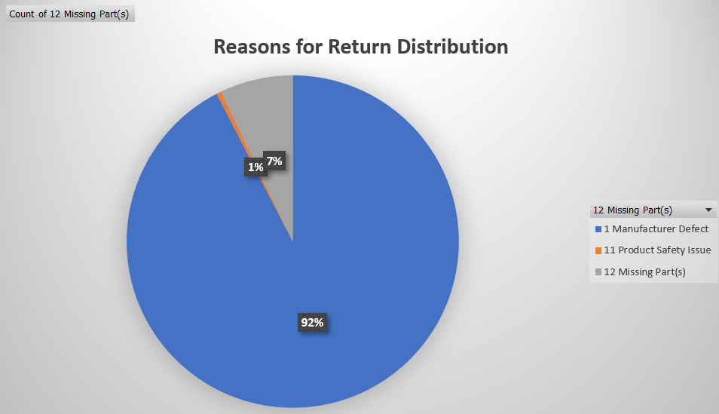
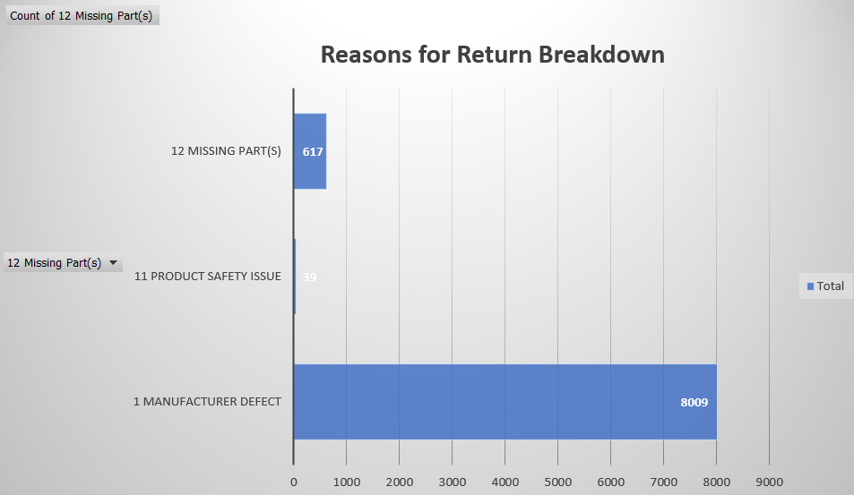
Reasons for return Breakdown
PIE CHART
Bar chart

Slide 6
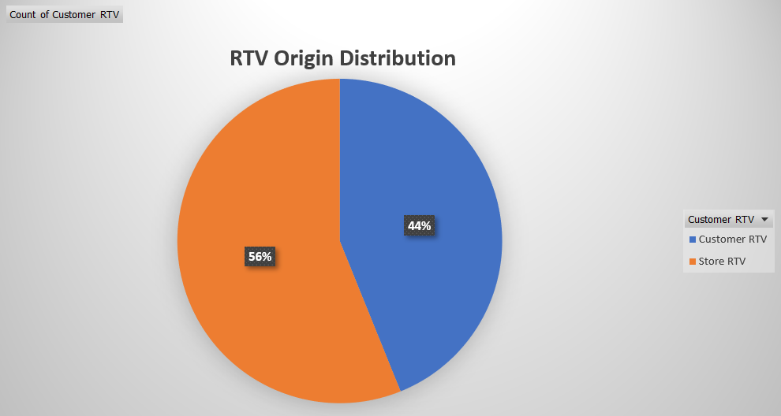
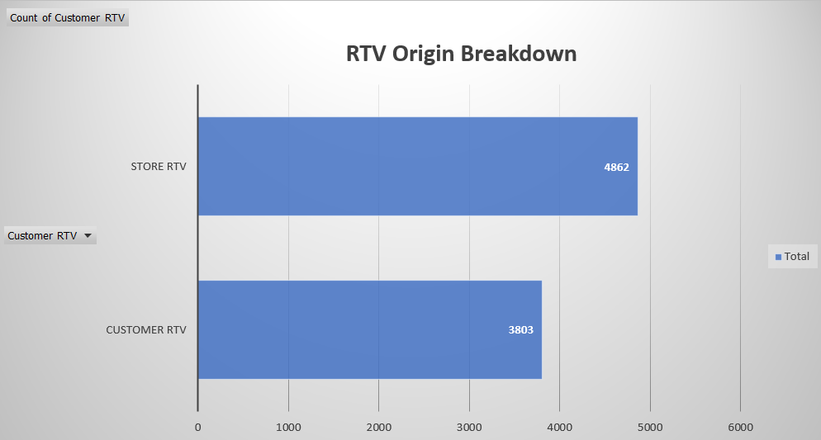
RTV Origin Breakdown
PIE CHART
Bar chart

Slide 7
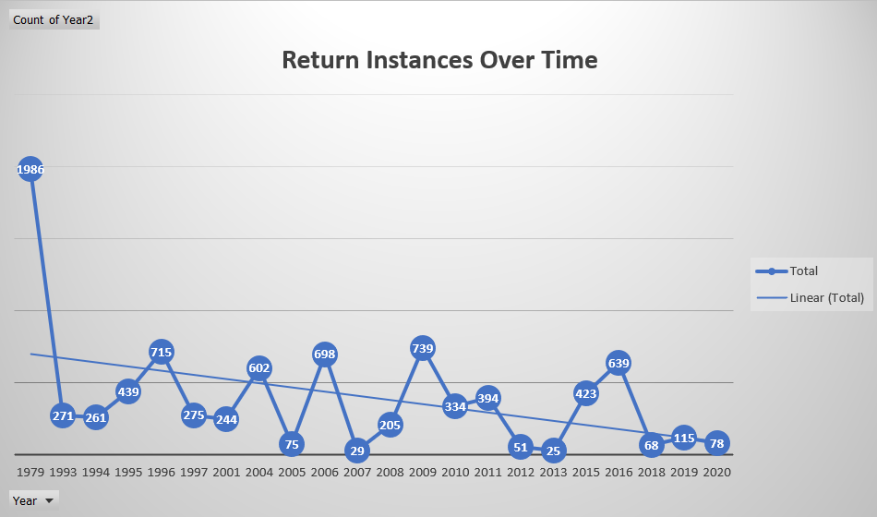
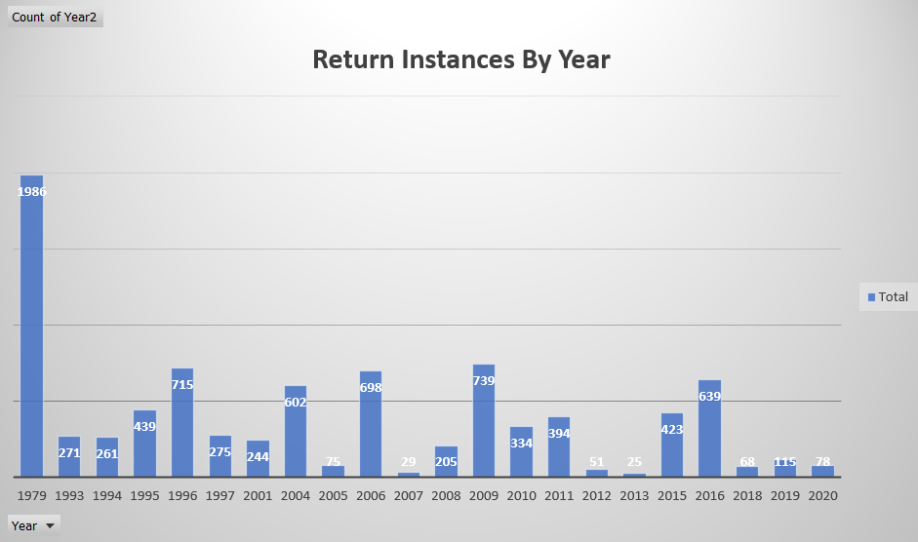
Yearly returns Breakdown
Line graph
Bar chart

Slide 8
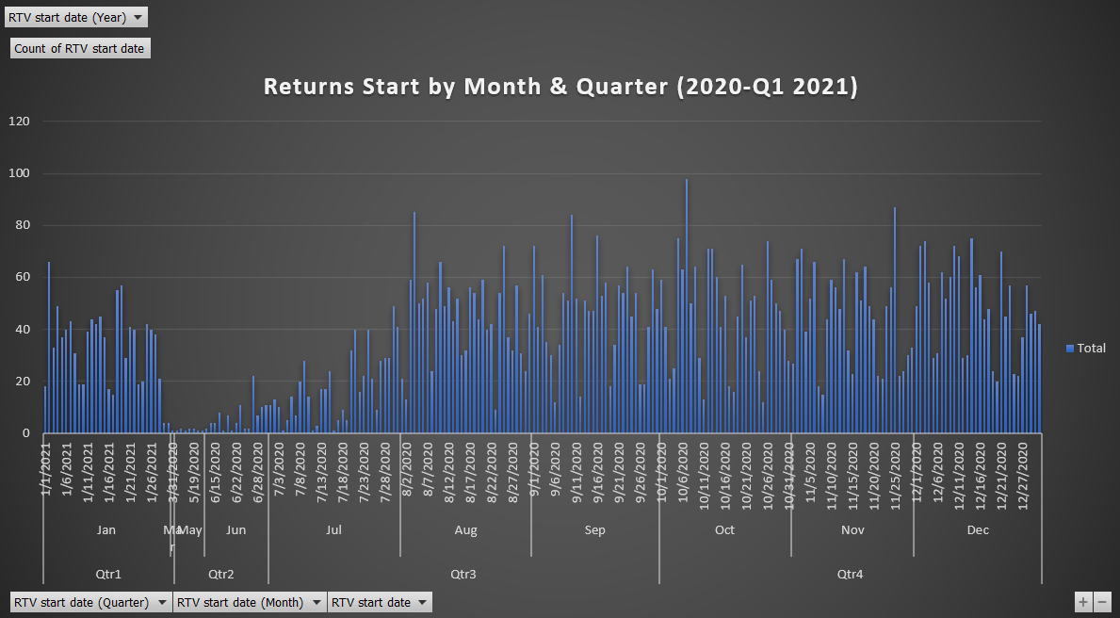
Return Start Dates

Slide 9
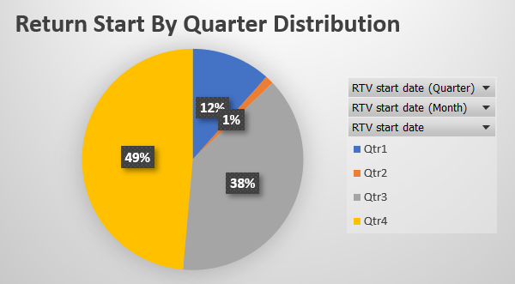
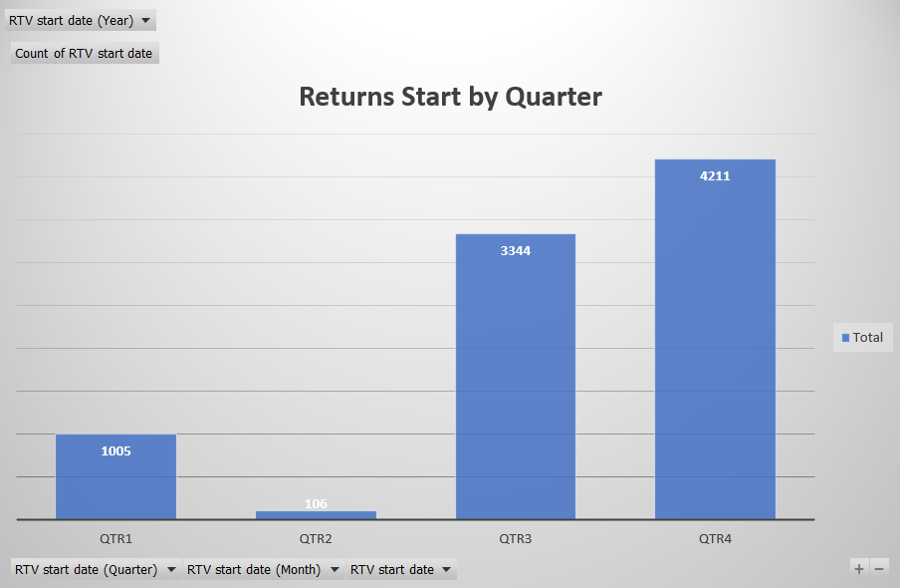
Returns start by quarter
Pie Chart
Bar Chart

Slide 10
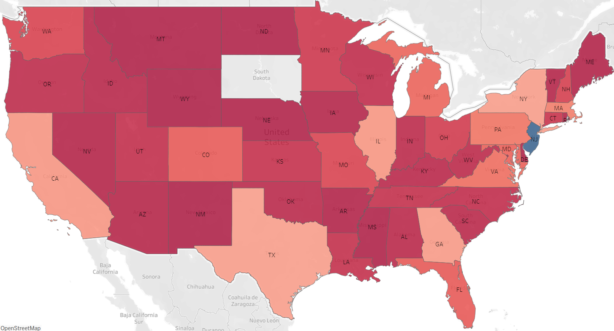

Return distribution by state

Slide 11
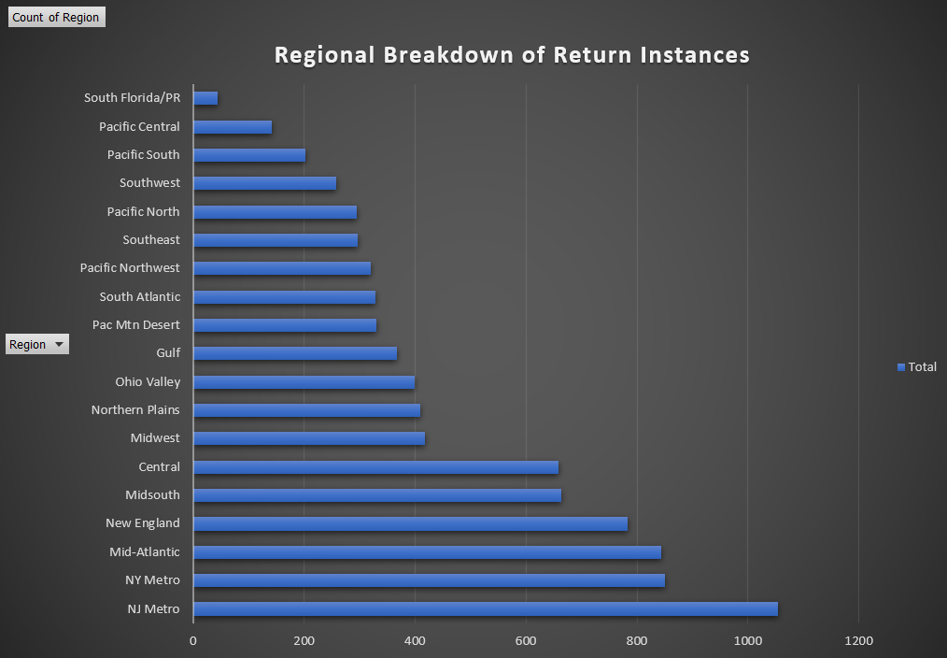
Regional Breakdown of return instances

Slide 12
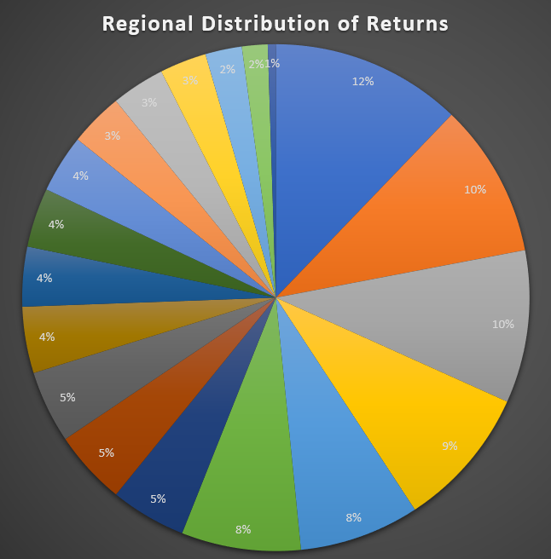
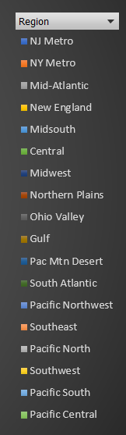
Regional distribution of returns

Slide 13
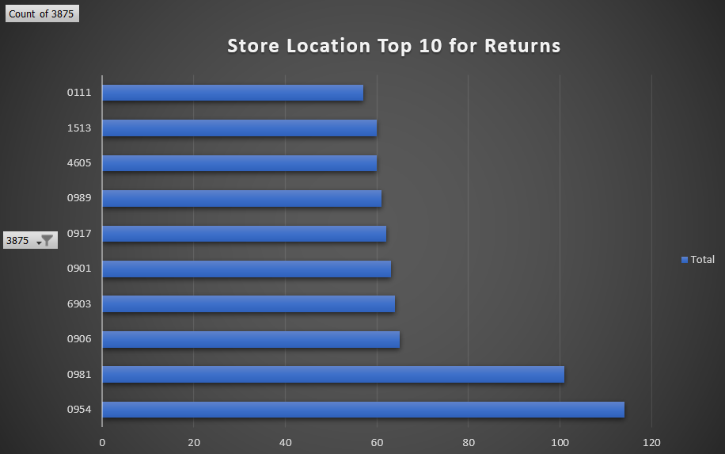
Store locations Returns breakdown
Top 10 Store Return Instances:
0954 – 114 Return Instances
0981 – 101 Return Instances
0906 – 65 Return Instance
6903 – 64 Return Instances
0901 – 63 Return Instances
0917 – 62 Return Instances
0989 – 61 Return Instances
4605 – 60 Return Instances
1513 – 60 Return Instances
0111 – 57 Return Instances

Slide 14
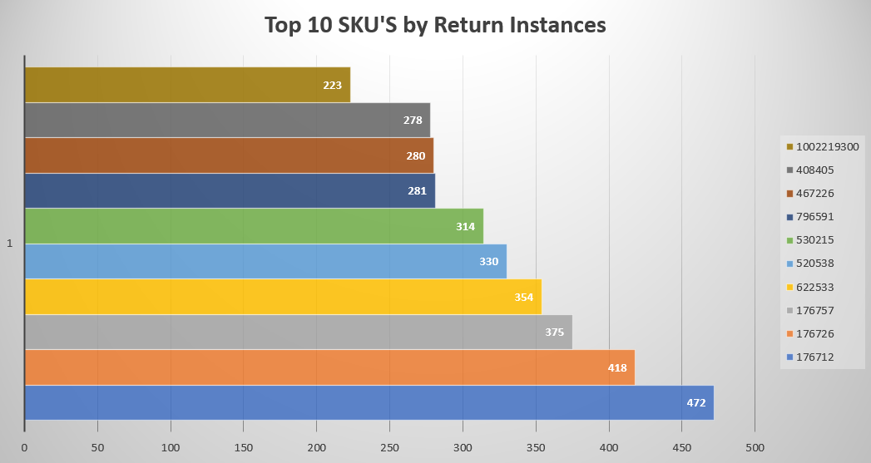
Sku’s Return Breakdown (~38%)

Slide 15
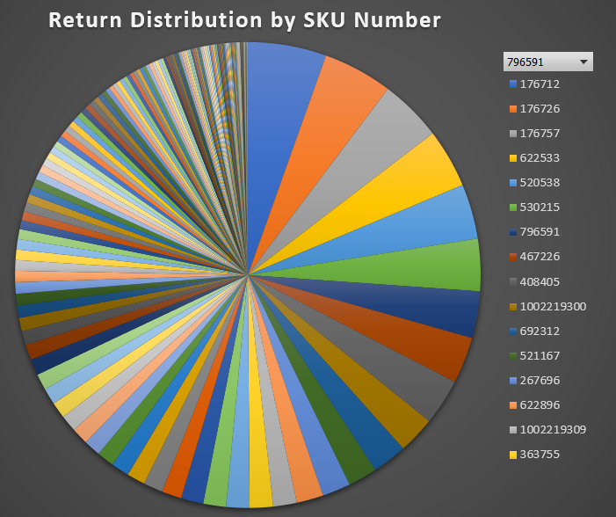
Top 16 Sku’s ~50% of All Return Instances

Slide 16
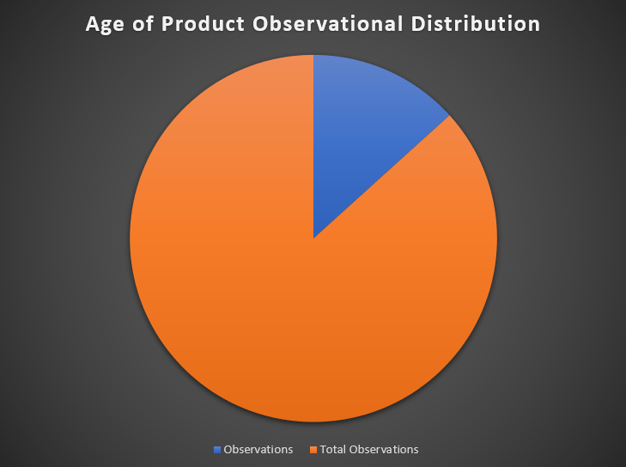
Age of product return review
Insufficient Data:
Out of a Possible 8,666 Observations, I Only Have 1,328 Observations
15% of Total Observations (Blue Slice)

Slide 17
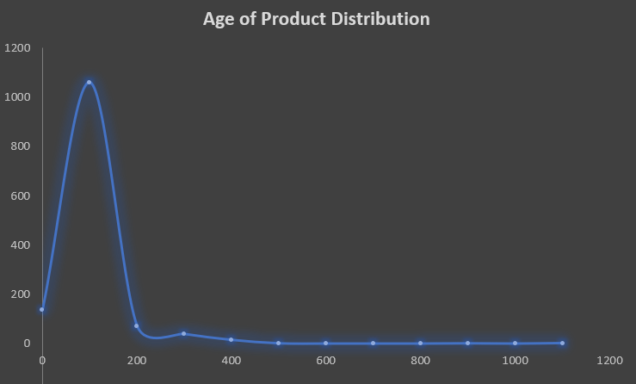
Age of product return analysis
Age of Product Does NOT Follow Normal Distribution
138 Return Instances Took 0 Days
4 Return Instances Exceeded 500 Days
2 Return Instances Exceed 1100 Days

Slide 18
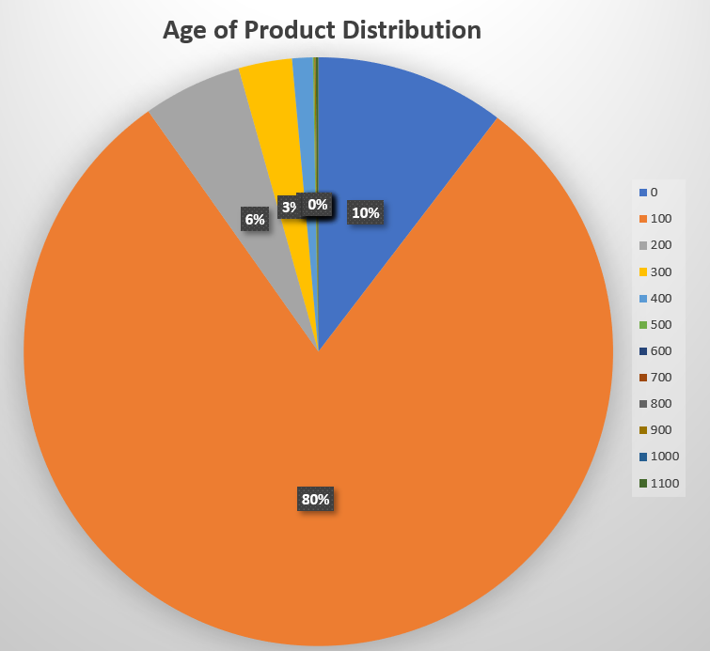
Age of product return breakdown
~10% of Return Instances Took 0 Days
~80% of Return Instances Took 1-100 Days
Median Age of Product Returns: ~10 Days
Mean Age of Product Returns: ~37 Days
~90% of Return Instances Occurred 0-100 Days
212 Observations Exceeded 60 Days (~16%)

Slide 19
Key insights
RETURNS MATTER!!!!!!
Manufacturing Defects Primary Reason for Returns (Overwhelmingly So)
Return Instances Are Mostly Stores Rather Than Customers
1,059 More Instances
Rate of Return Instances Have Decreased Over Time
Indication of Continuous Business Process Improvements
Returns Possess Seasonality Behaviors
87% of Returns Occur in Latter Half of Year
Nearly 50% of All Returns Occur in Quarter 4

Slide 20
Key insights (cont.)
New Jersey Has Most Return Instances Relative to Other States
Overwhelming So
Nearly 50% of All Returns Originate in Only 5 US Regions
NJ Metro, NY Metro, Mid-Atlantic, New England, Mid-South
Store 0954 Has Most Return Instances (0954 Union – RT 22 New Jersey)
Not All SKU’s Are Created Equal
SKU Number 176712 Has Most Return Instances
Top 10 SKU’s by Return Account for ~38% of All Returns & Top 16 SKU’s Account for ~50% of All Returns
~90% of All Returns Take 0-100 Days to Complete
Mean Age of Product Return is ~37 Days
Median Age of Product Return is ~10 Days

Slide 21
Recommendations moving forwards
Data is Lacking Completeness => Implement Cloud/Relational Database System
Makes Some Advanced Analysis Infeasible
Replace Return Comment Cards w/ Survey Designed to Collect Relevant Info
Improve Manufacturing Process => Significant Decrease in Returns
Focus on Decreasing Defects in Top 16 SKU’s Aforementioned
Standardize Product SKU’s into Six-Digit Code => Analysis Much Easier
Plan Accordingly => Less Business Risk
Understand Most Returns Occur in Final Months of Year
Inventory & Financial Forecasts Must Take This into Account for Accuracy

Slide 22
Recommendations moving forwards (cont.)
Endeavor to Understand Why so Many Returns are in New Jersey => Decrease Returns
Focus on Decreasing Return Rate in Top 5 Regions Aforementioned
Improve Return Process => Better Customer Experience
Endeavor to Get Return Lifecycle Under 1 Month on Average

Slide 23
Thank-you
QUESTIONS???

